Slide 1
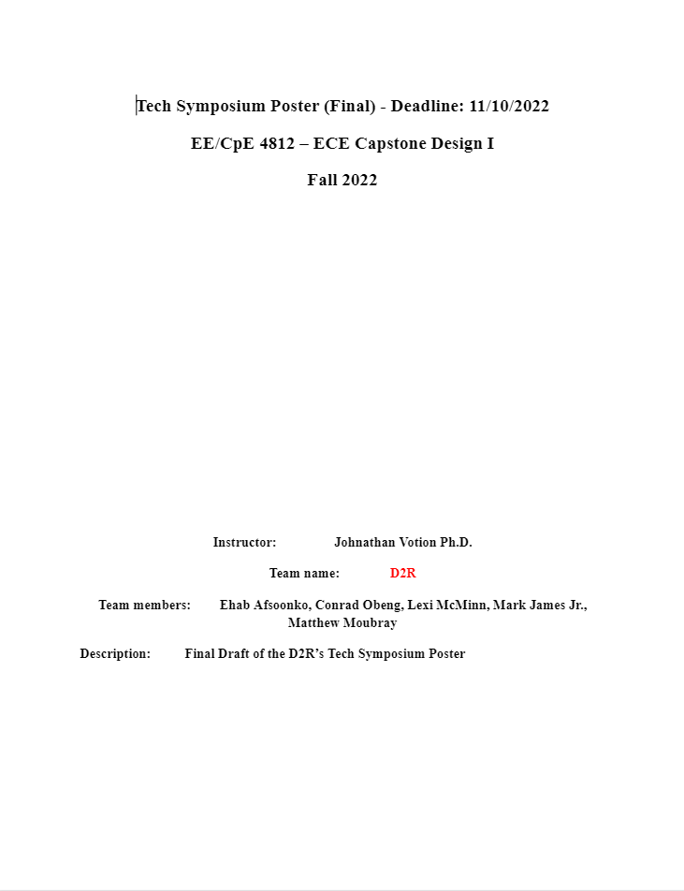

Slide 2


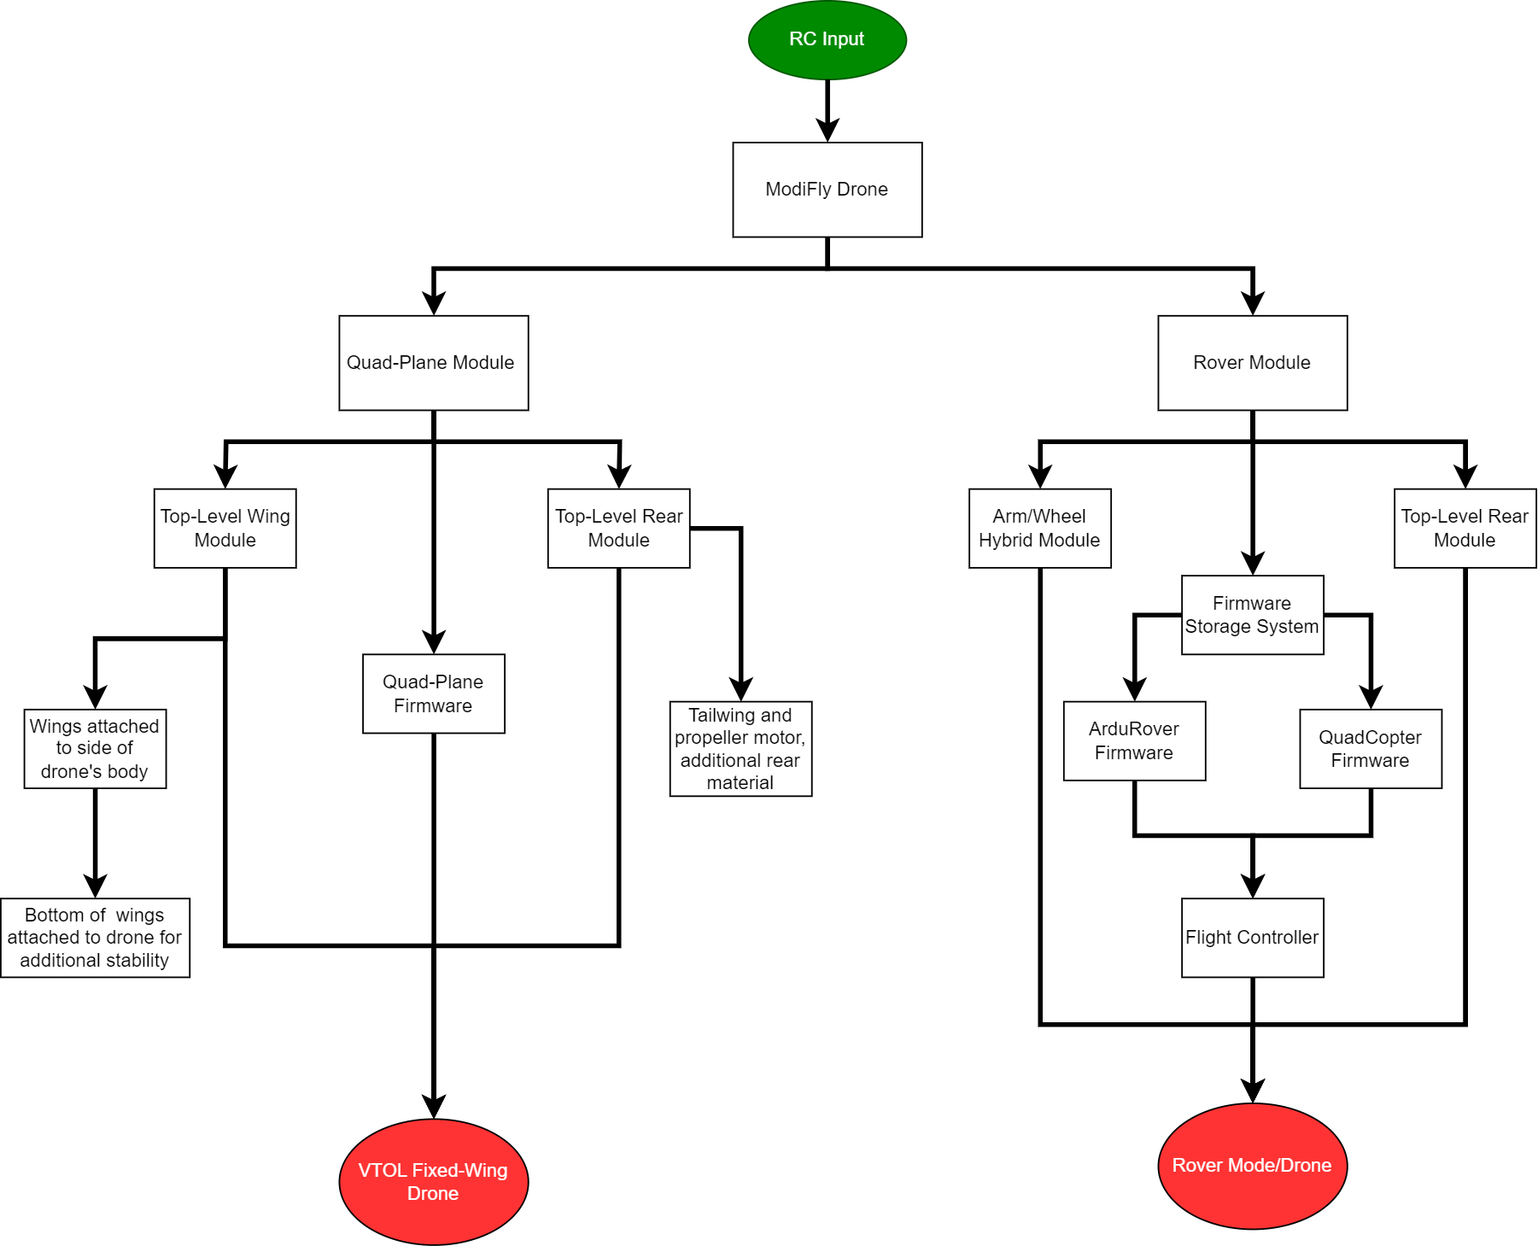
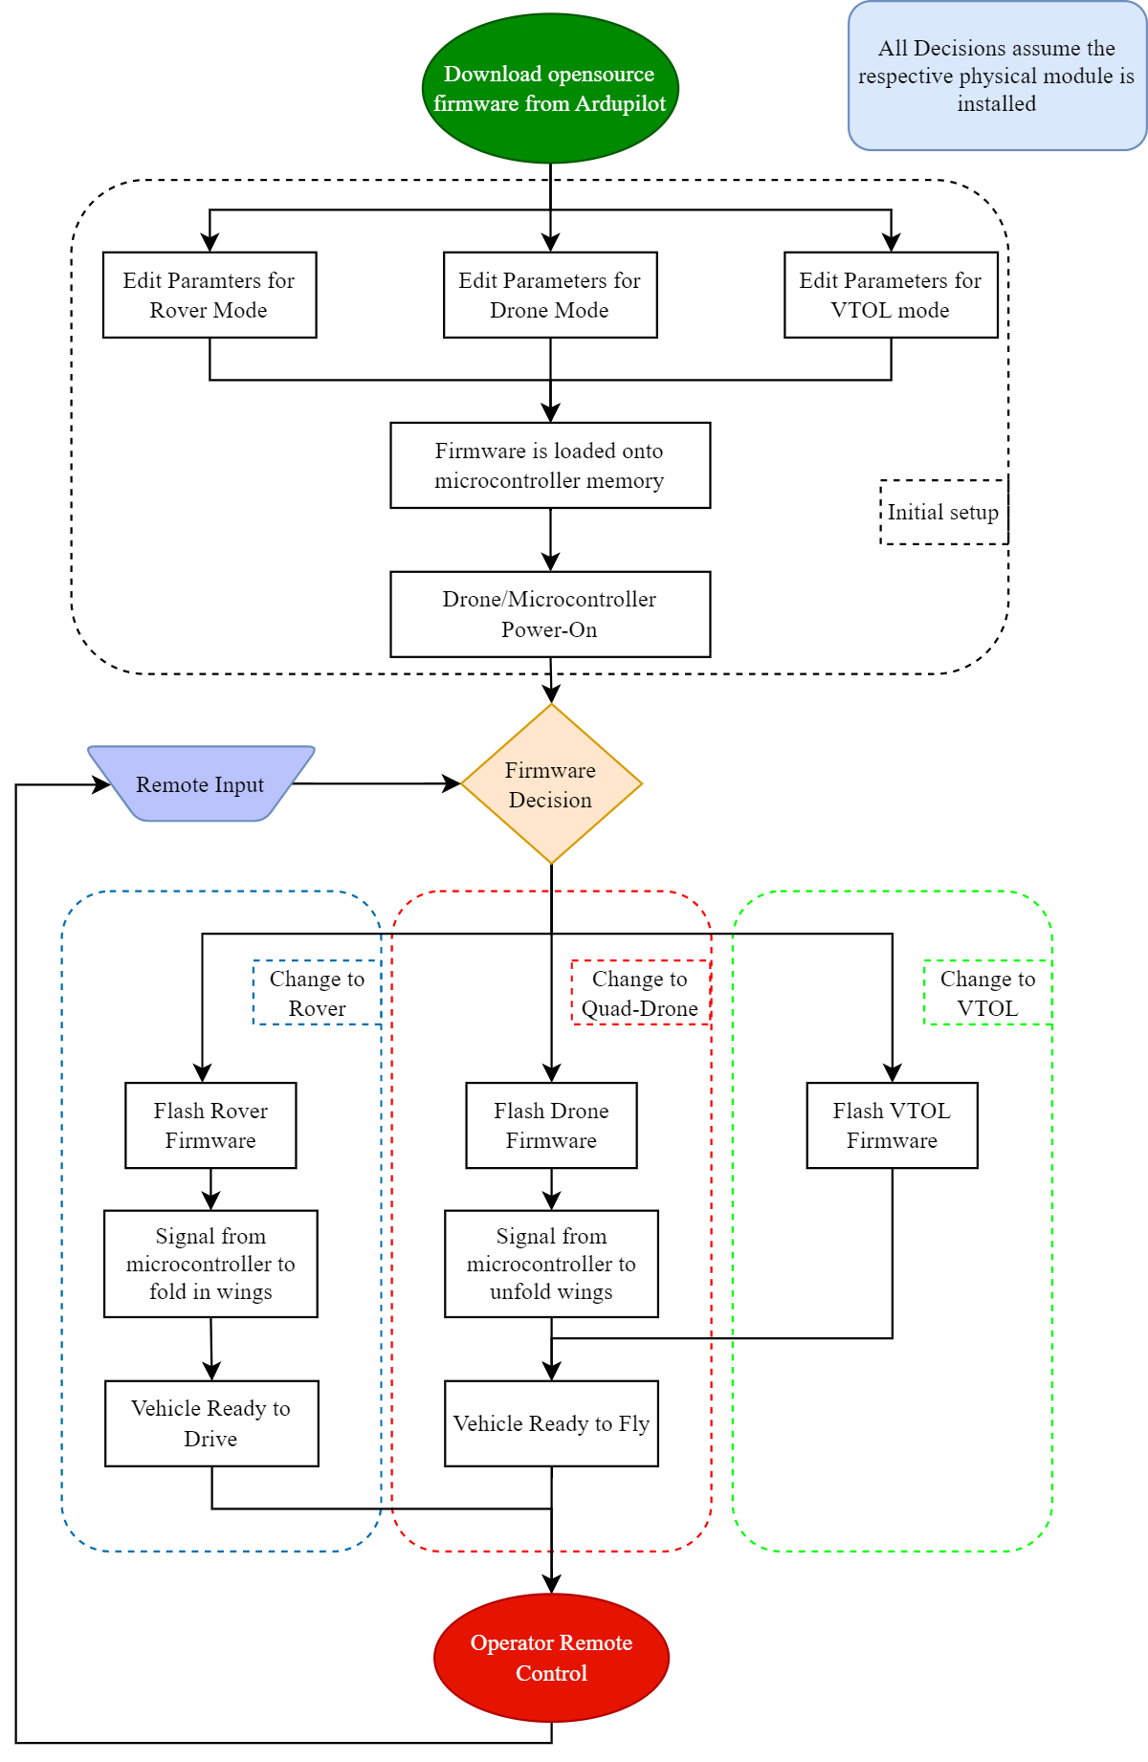
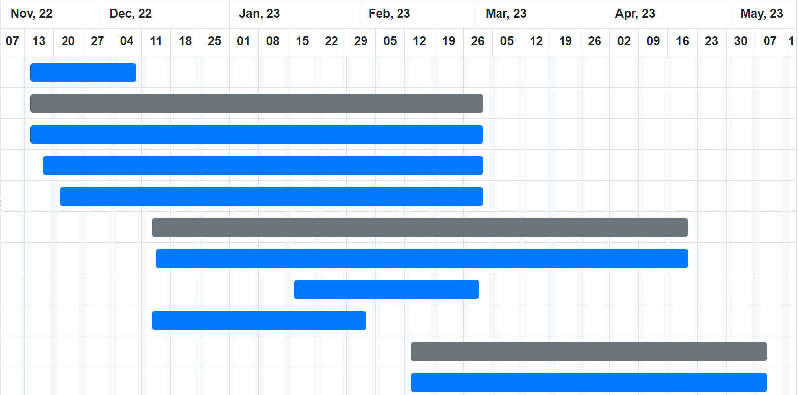
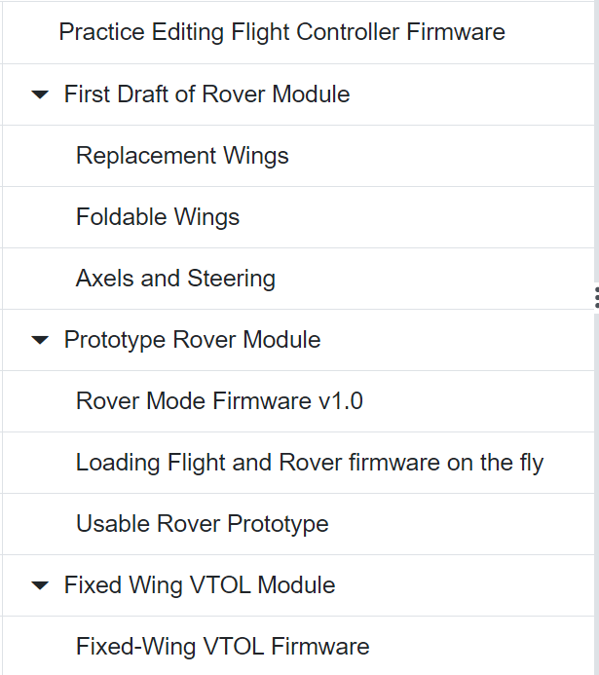
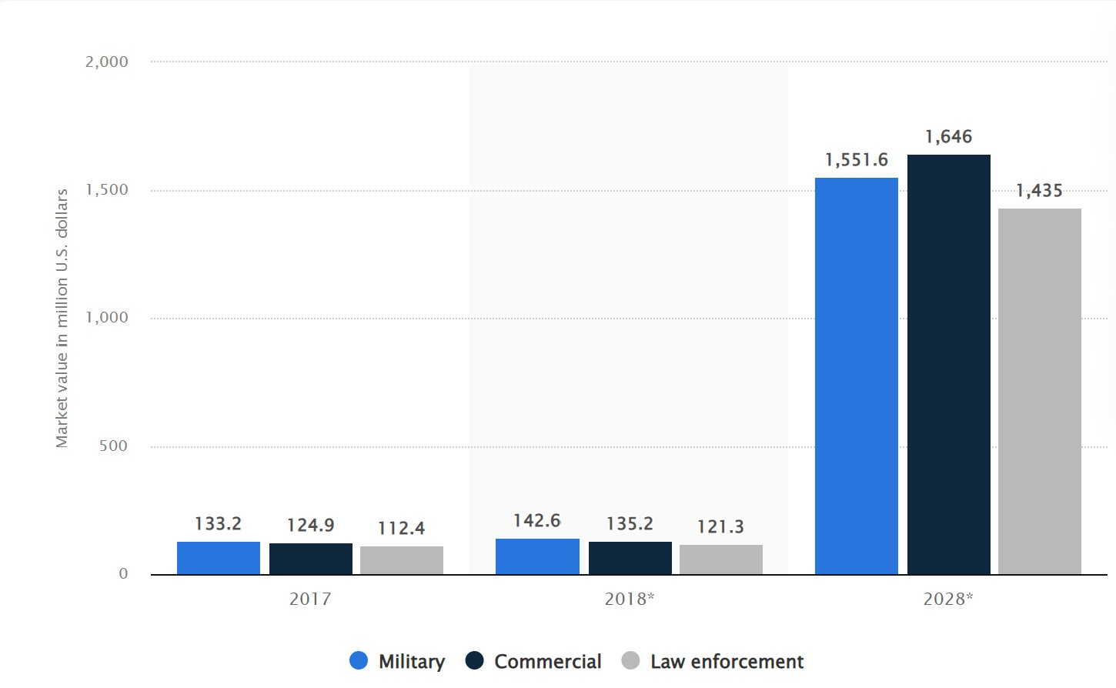
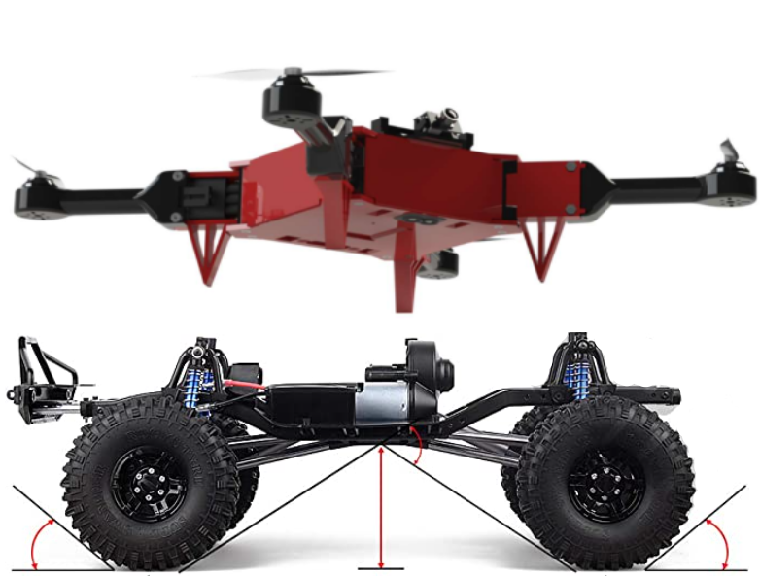
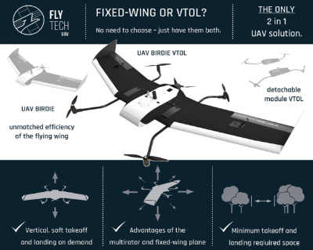
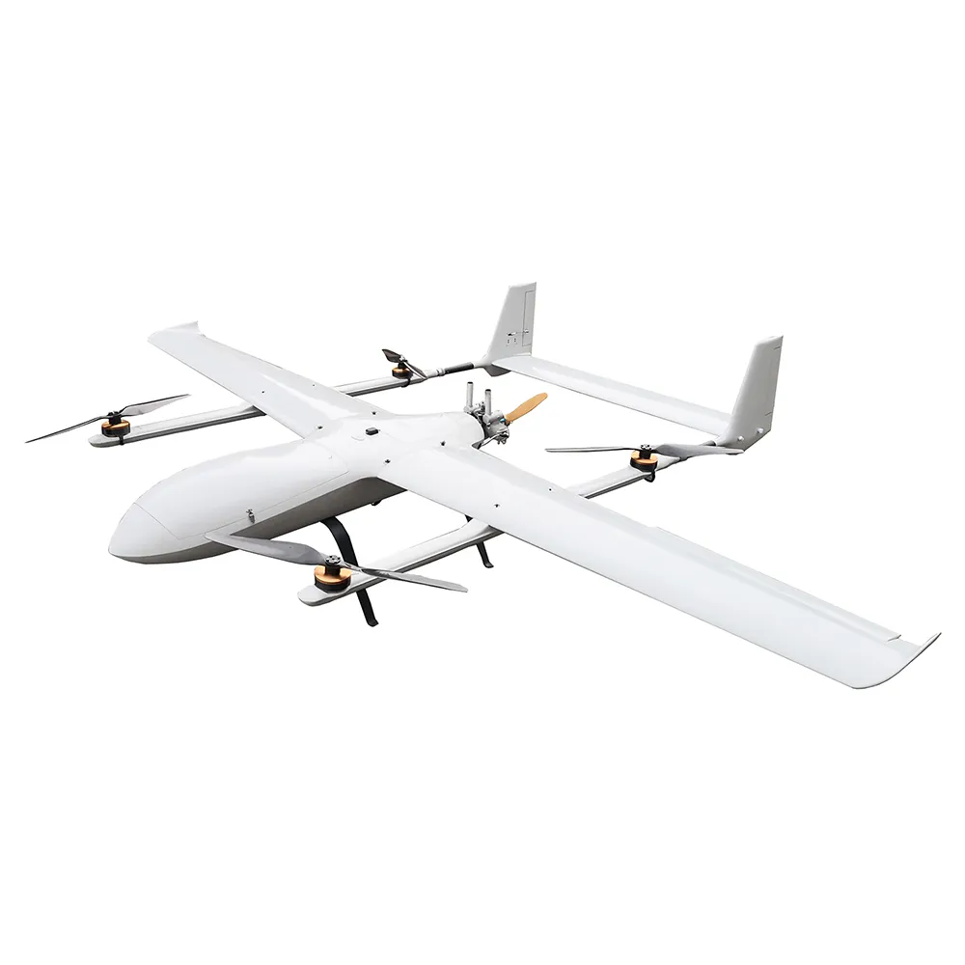
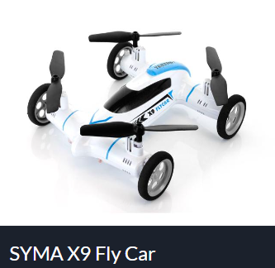
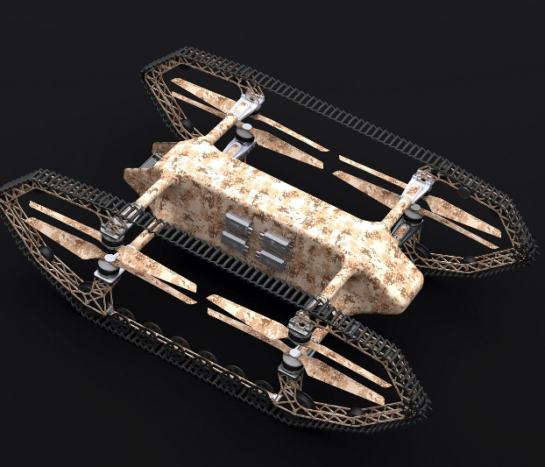
Alternative Transportation Modes for UAV Systems
Sponsor: USL Lab, UTSA
Ehab Afsoonko, Conrad Obeng, Lexi McMinn, Mark James Jr., Matthew Moubray
Abstract
Functional Block Diagram
Components
This project aims to expand the number of vehicle transportation modalities traditionally associated with QuadCopter Drones, so that customers are not pigeon-holed into one method of transportation. Specifically, the project aims to bring VTOL Fixed-Wing and Rover transportation modes to a drone, allowing for longer flight times with less battery, and ground-based transportation, respectively.
Flywoo Goku F745 Flight Controller
ModiFly Drone Platform
VTOL Fixed-Wing Module (Connector, wings, propeller, etc)
Rover Module (Connector, wheels, etc)
Work Breakdown Structure
Need for Product
Month 1 - November:
Download and familiarize with flight controller firmware
Begin first design of Rover mode modules
Month 2 - December/January
Prototype of Rover module
First firmware modification test
Implement Firmware swapping
Month 3 - February
Begin prototyping Fixed-wing VTOL & firmware
Continued development of Rover module
Month 4 - March
Rover Module in final state, firmware close
Fixed-Wing VTOL development continued
Month 5 - April to End
Rover Module with switching capability implemented and fully document
Fixed-wing VTOL module and firmware fully implemented
If an end-user only has a single UAV/UGV/unmanned system, that machine is limited to a single transportation modality. However, having separate re-attachable modules for different movement options allows the operator to change the functionality of the unmanned system without needing to purchase an additional system. Currently, most professional Fixed-Wing VTOL UAVs can cost anywhere from $1,000 to $20,000. By creating a Fixed-Wing VTOL and Rover re-attachable module, we enable the ModiFly Drone to be an extremely versatile and adaptable UAV versus it’s competitors, while also saving the consumer both time and money.
Fig. 7 Function Block Diagram
Design Concept
Software Flowchart
The goal is to add multiple reattachable-modules to an existing drone framework model with the intent to expand and improve the functionality. The primary module will add rover functionality that allows the drone to be able to land and switch to a ground-based transportation mode. The Rover module should be able to switch modes without needing the operator to be in close proximity, as well as preserve the flight or drive data between mode switches. The current solution is to design a new arm module that replaces the previous feet with a wheel, axle, and transmission assembly without adding too much weight to interfere with the flight capabilities. The second module will be a Fixed-Wing module that will allow for increased flight duration while retaining the Vertical Take-off and Landing capabilities already present on the base drone.
Major Features
Air and ground transportation modes without operator’s physical interaction
Fixed-wing VTOL Module
Foldable wing design for Rover mode
Flight/drive data consistency between mode changes
Fig. 9 Gantt Chart
Picture References
Acknowledgments
The Drone To Rover(D2R) team would like to give a special thanks to Dr. Yongcan Cao, ECE, USL Lab, UTSA, and Josh Barron for the technical and financial support of our project. We would also like to recognize the UTSA Makerspace, Student Success Center, and the UTSA ECE department faculty and staff for providing the resources, instruction and support related to this project.
Fig. 1 Size of the global fixed-wing hybrid vertical take-off and landing (VTOL) UAVs market from 2017 to 2028, by end-user
Fig. 2 Image of the ModiFly Drone platform
Fig. 3 (top) Flytech Birdie VTOL Module
Fig. 5 (top) VTOL Fixed-Wing Drone
Fig. 8 Software Flowchart
Fig. 4 (bottom) SYMA X9 Fly Car
Fig. 6 (bottom) HUUVER Hybrid Drone

Slide 3
